Slide 1
ENGINEERING ECONOMY
LECTURE 2
PROF.DR. YASEMİN ASU ÇIRPICI, MU, DEPT. OF ECONOMICS

Slide 2
Terminology and Symbols
P: value or amount of money at present or time 0.
Present Worth (PW)
Present Value (PV)
Net Present Value (NPV)
F: value or amount of money at some future time.
Future Worth (FW)
Future Value (FV)
A: series of consecutive, equal, end-of-period amounts of money.
n: number of interest periods
i: interest rate or rate of return per time period
compound unless otherwise stated
expressed as percent per interest period
t: time stated in periods

Slide 3
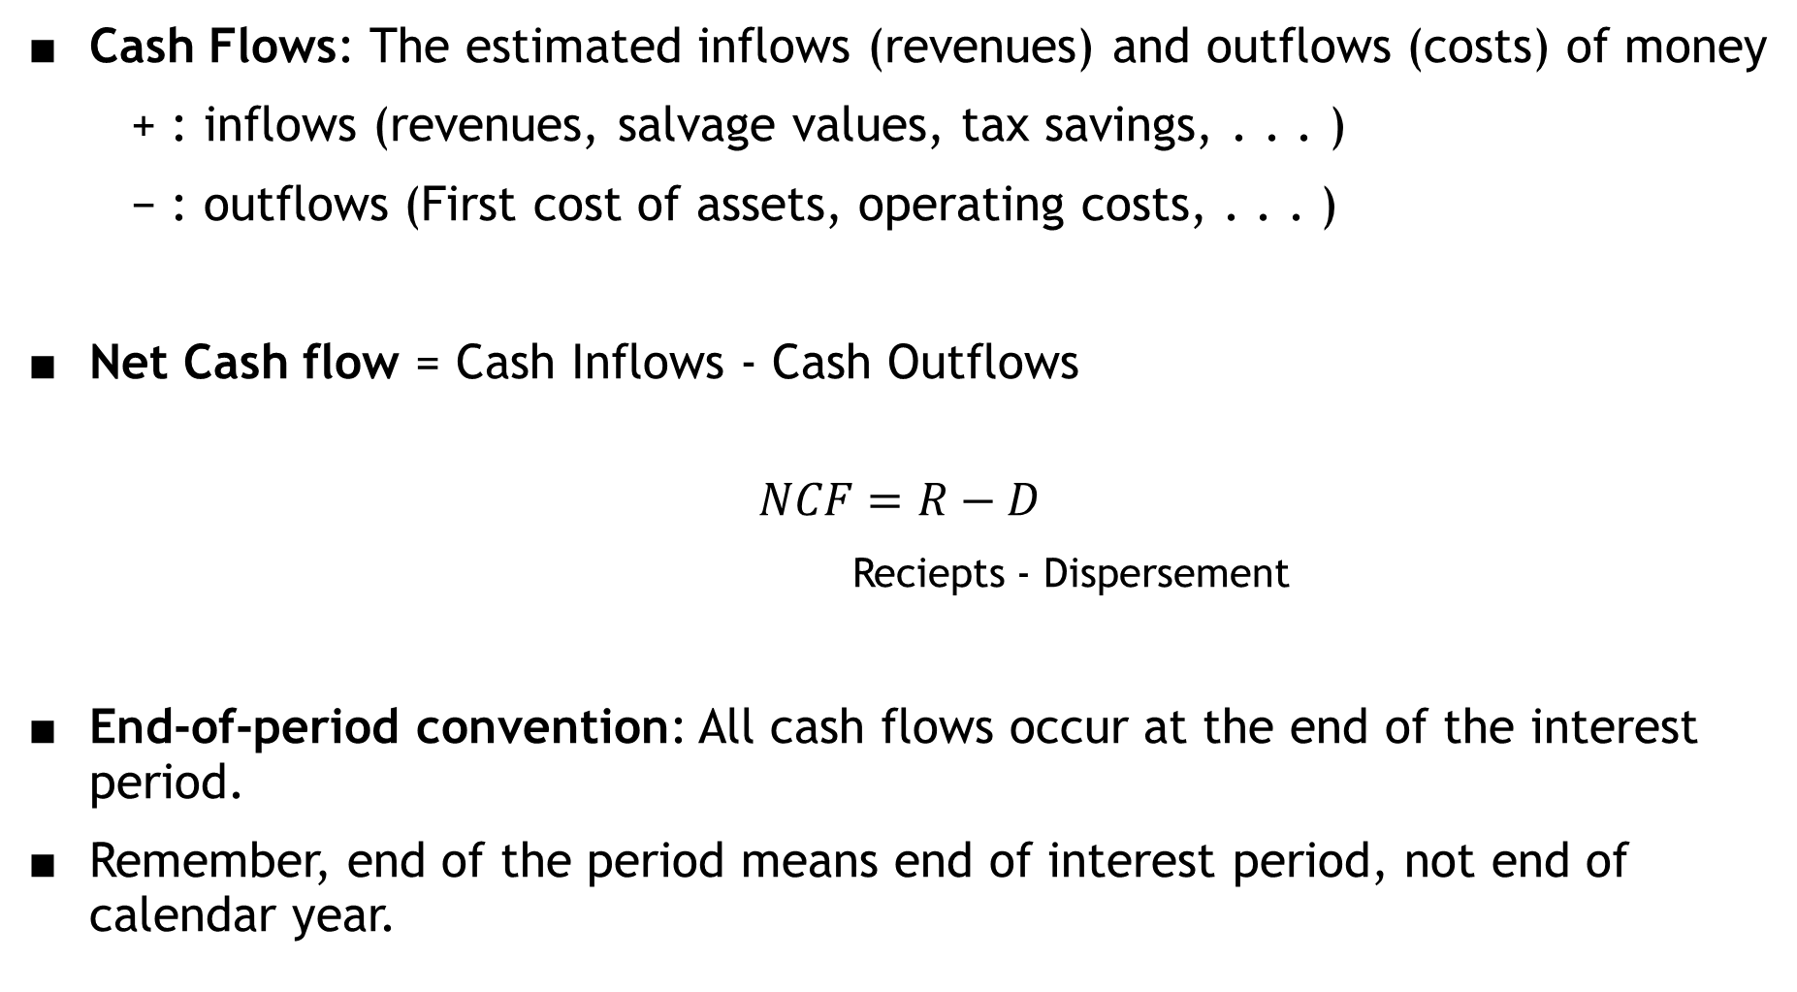
Cash Flows: The estimated inflows (revenues) and outflows (costs) of money
+ : inflows (revenues, salvage values, tax savings, . . . )
− : outflows (First cost of assets, operating costs, . . . )
Net Cash flow = Cash Inflows - Cash Outflows
$$NCF=R−D$$
Reciepts - Dispersement
End-of-period convention: All cash flows occur at the end of the interest period.
Remember, end of the period means end of interest period, not end of calendar year.

Slide 4
Cash Flow Diagram: Graphical representation of cash flows drawn on a time scale
includes what is known, what is estimated, what is needed
time t = 0: the present, t = 1 is the end of time period 1
Vertical arrow pointing up indicates cash inflow (+).
Vertical arrow pointing down indicates cash outflow flow (−)
The perspective must be determined before placing signs on the cash flows

Slide 5
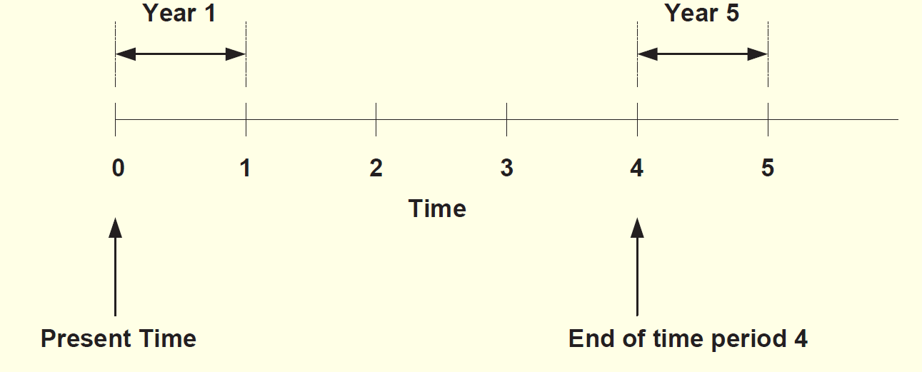
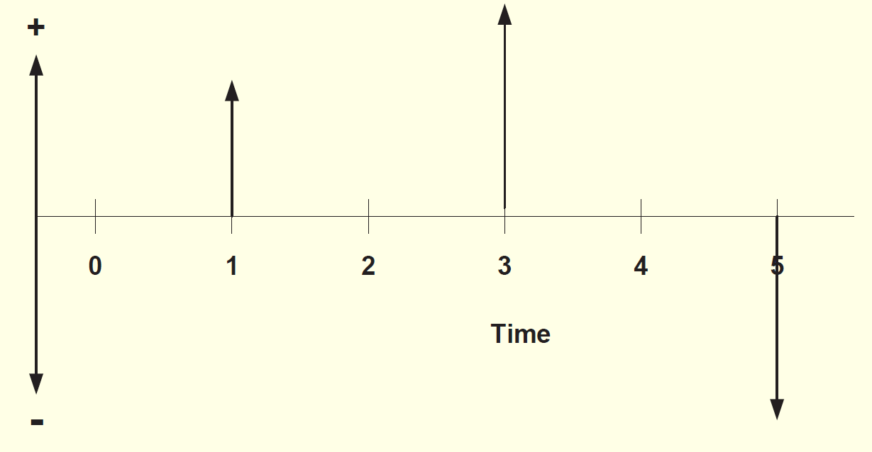

Slide 6
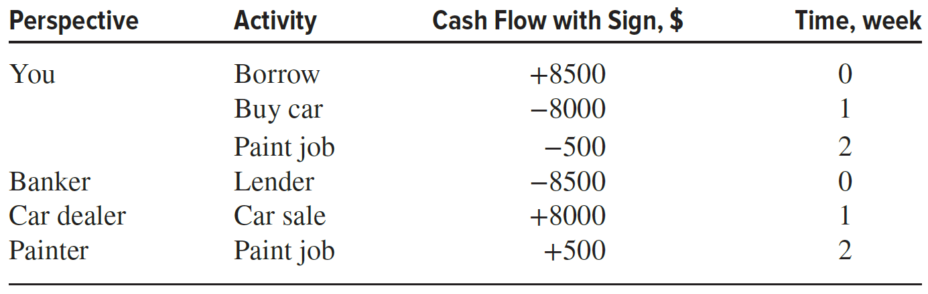
Assume you borrow $8500 from a bank today to purchase an $8000 used car for cash next week, and you plan to spend the remaining $500 on a new paint job for the car 2 weeks from now.
There are several perspectives possible when developing the cash flow diagram—those of the borrower (that’s you), the banker, the car dealer, or the paint shop owner. The cash flow signs and amounts for these perspectives are as follows.

Slide 7
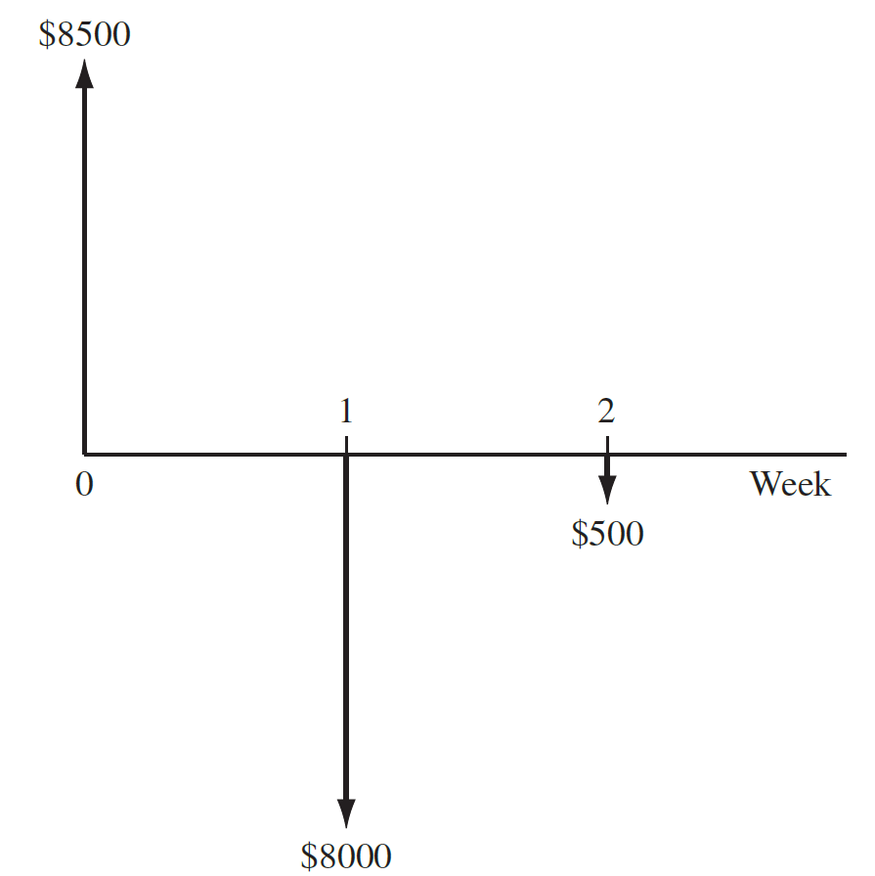
One, and only one, of the perspectives is selected to develop the diagram.
For your perspective, all three cash flows are involved and the diagram appears as shown in Figure with a time scale of weeks.
Applying the end-of-period convention, you have a receipt of +$8500 now (time 0) and cash outflows of −$8000 at the end of week 1, followed by −$500 at the end of week 2.

Slide 8
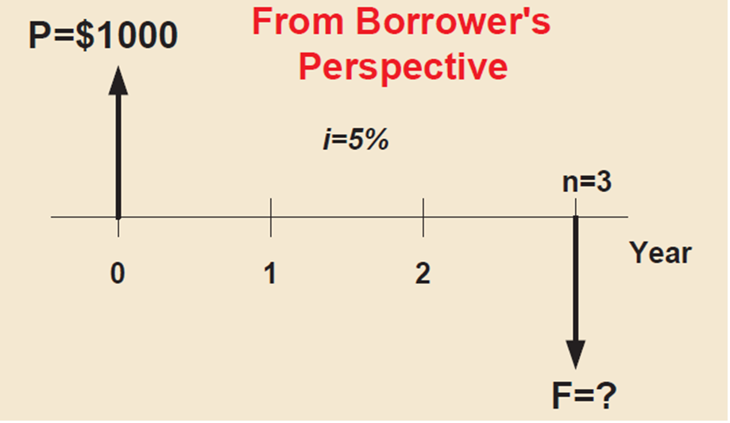
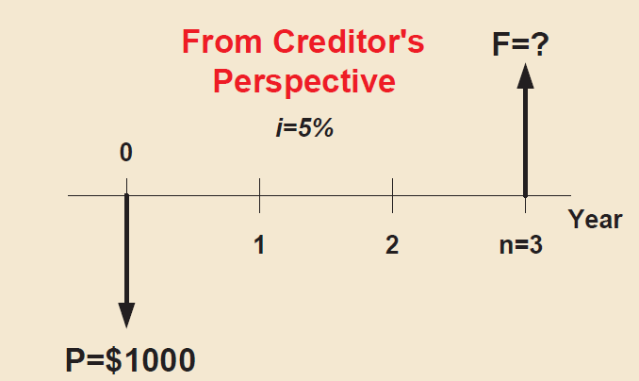
EXAMPLE
321 Credit Union loaned money to an engineer. The loan is for $1,000 for 3 years at 5% per year. How much money will the engineer repay at the end of 3 years? Construct the cash flow diagram?

Slide 9
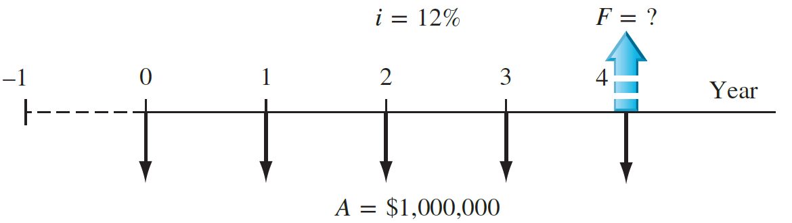
EXAMPLE
Each year Exxon-Mobil expends large amounts of funds for mechanical safety features throughout its worldwide operations. Carla Ramos, a lead engineer for Mexico and Central American operations, plans expenditures of $1 million now and each of the next 4 years just for the improvement of field-based pressure-release valves. Construct the cash flow diagram to find the equivalent value of these expenditures at the end of year 4, using a cost of capital estimate for safety-related funds of 12% per year.

Slide 10
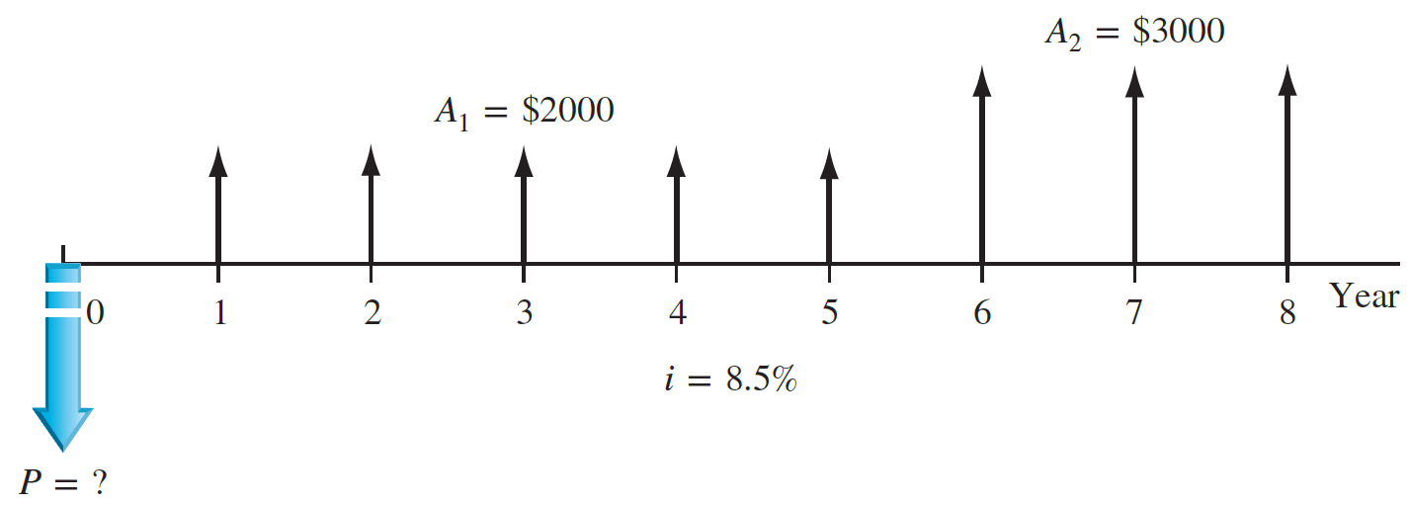
EXAMPLE
An electrical engineer wants to deposit an amount P now such that she can withdraw an equal annual amount of A1 = $2000 per year for the first 5 years, starting 1 year after the deposit, and a different annual withdrawal of A2 = $3000 per year for the following 3 years. How would the cash flow diagram appear if i = 8.5% per year?

Slide 11
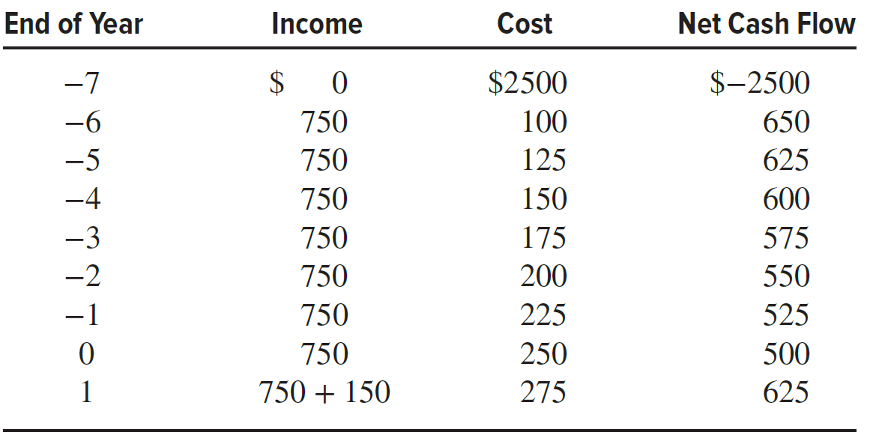
EXAMPLE
A rental company spent $2500 on a new air compressor 7 years ago. The annual rental income from the compressor has been $750. The $100 spent on maintenance the first year has increased each year by $25. The company plans to sell the compressor at the end of next year for $150. Construct the cash flow diagram from the company’s perspective and indicate where the present worth now is located.

Slide 12
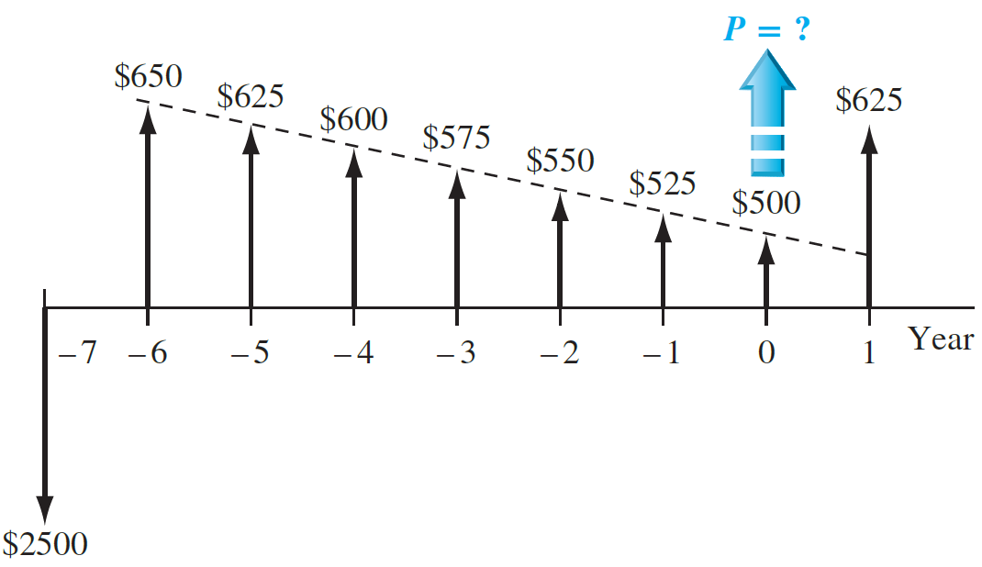

Slide 13
Economic equivalence
Economic equivalence is a combination of interest rate and time value of money to determine the different amounts of money at different points in time that are equal in economic Economic equivalence value.
As an illustration, if the interest rate is 6% per year, $100 today (present time) is equivalent to $106 one year from today.
Amount accrued = 100 + 100(0.06) = 100(1 + 0.06) = $106
If someone offered you a gift of $100 today or $106 one year from today, it would make no difference which offer you accepted from an economic perspective. In either case you have $106 one year from today.

Slide 14
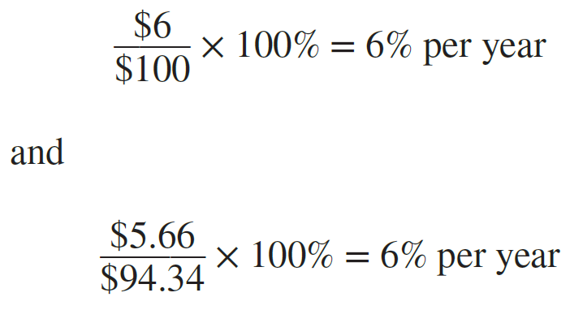
In addition to future equivalence, we can apply the same logic to determine equivalence for previous years.
A total of $100 now is equivalent to $100∕1.06 = $94.34 one year ago at an interest rate of 6% per year.
From these illustrations, we can state the following: $94.34 last year, $100 now, and $106 one year from now are equivalent at an interest rate of 6% per year.
The fact that these sums are equivalent can be verified by computing the two interest rates for 1-year interest periods.

Slide 15
EXAMPLE
Manufacturers make backup batteries for computer systems available to Batteries+Bulbs dealers through privately owned distributorships. In general, batteries are stored throughout the year, and a 5% cost increase is added each year to cover the inventory carrying charge for the distributorship owner. Assume you own the City Center Batteries+Bulbs outlet. Make the calculations necessary to show which of the following statements are true and which are false about battery costs.
(a) The amount of $98 now is equivalent to a cost of $105.60 one year from now.
(b) A truck battery cost of $200 one year ago is equivalent to $205 now.
(c) A $38 cost now is equivalent to $39.90 one year from now.
(d) A $3000 cost now is equivalent to $2887.14 one year earlier.
(e) The carrying charge accumulated in 1 year on an investment of $20,000 worth of batteries is $1000.

Slide 16
(a) The amount of $98 now is equivalent to a cost of $105.60 one year from now.
Total amount accrued = 98(1.05) = $102.90 ≠ $105.60; therefore, it is false.
Another way to solve this is as follows: Required original cost is 105.60∕1.05 = $100.57 ≠ $98.
(b) A truck battery cost of $200 one year ago is equivalent to $205 now.
Equivalent cost 1 year ago is 205.00∕1.05 = $195.24 ≠ $200; therefore, it is false.
(c) A $38 cost now is equivalent to $39.90 one year from now.
The cost 1 year from now is $38(1.05) = $39.90; true.

Slide 17
(d) A $3000 cost now is equivalent to $2887.14 one year earlier.
Cost now is 2887.14(1.05) = $3031.50 ≠ $3000; false.
(e) The carrying charge accumulated in 1 year on an investment of $20,000 worth of batteries is $1000.
The charge is 5% per year interest, or $20,000(0.05) = $1000; true.

Slide 18
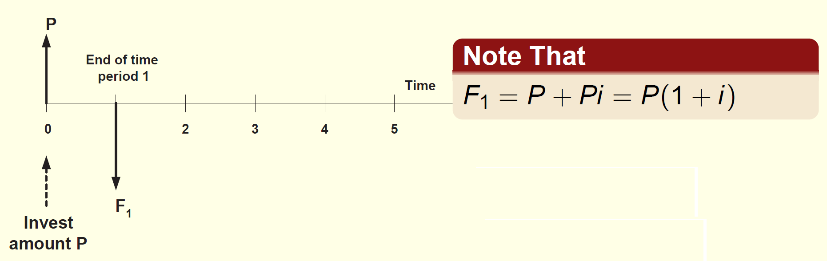
Future Value
The most fundamental factor in engineering economy is the one that determines the amount of money F accumulated after n periods from a single present worth P, with interest compounded one time per period.

Slide 19
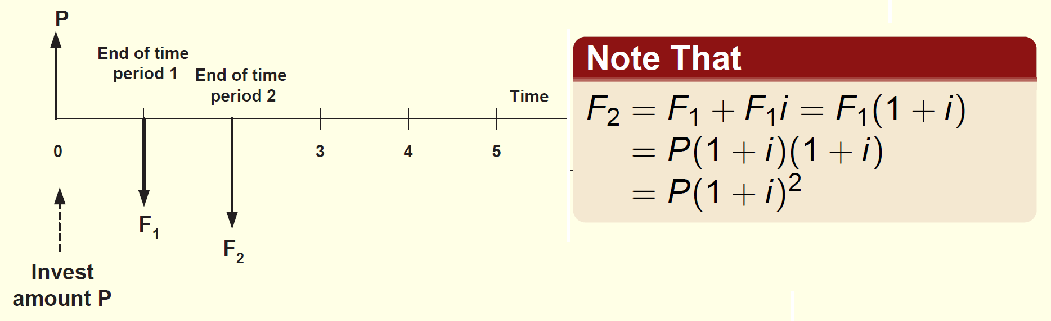
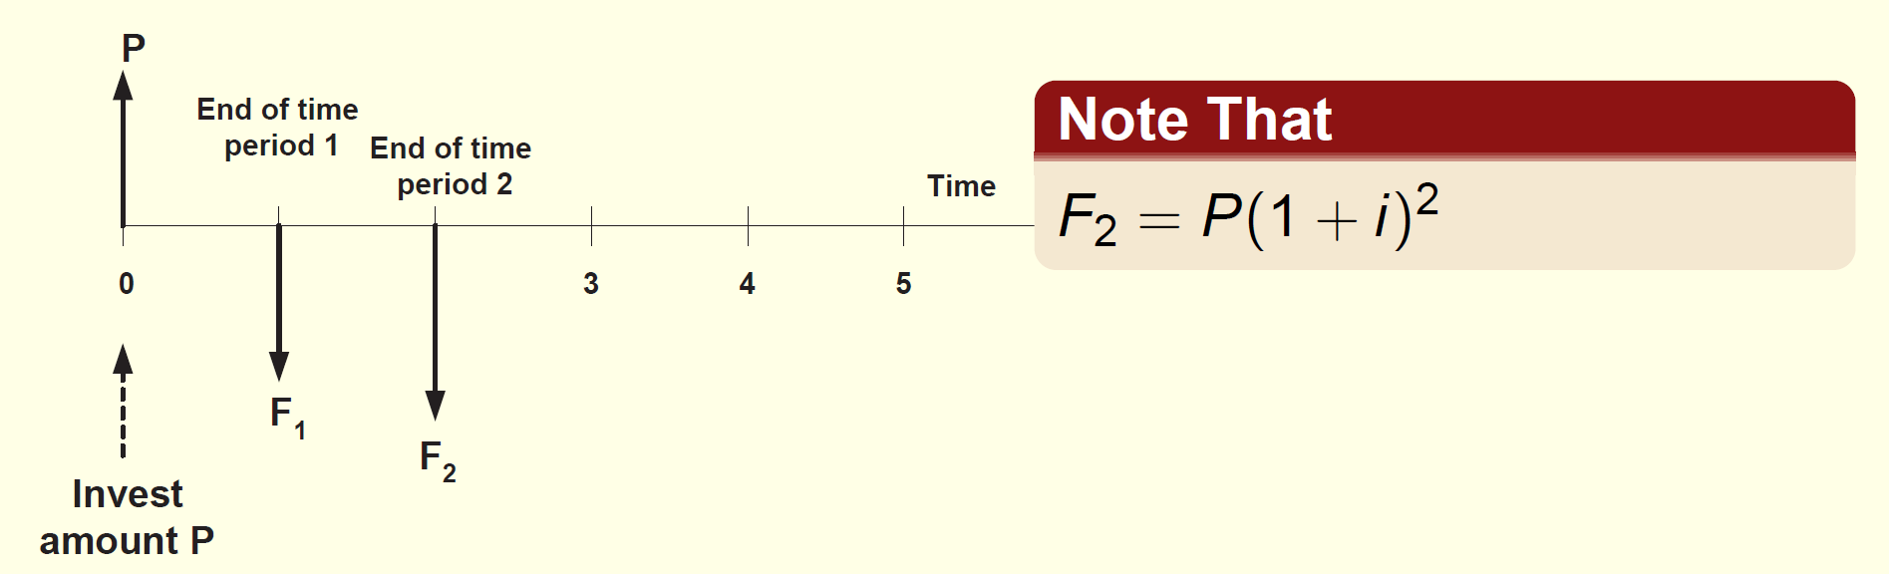

Slide 20
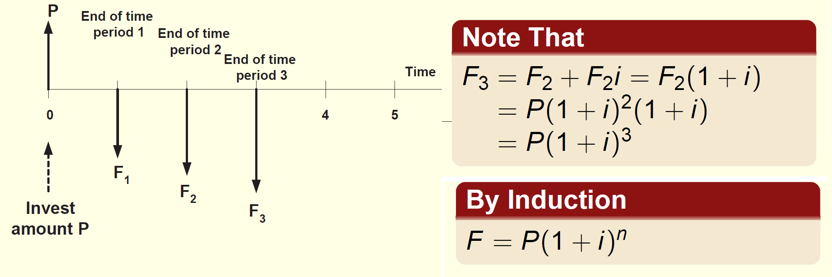
The factor (1 + i)^{n} is called the single payment compound amount factor, or simply F/P factor.

Slide 21
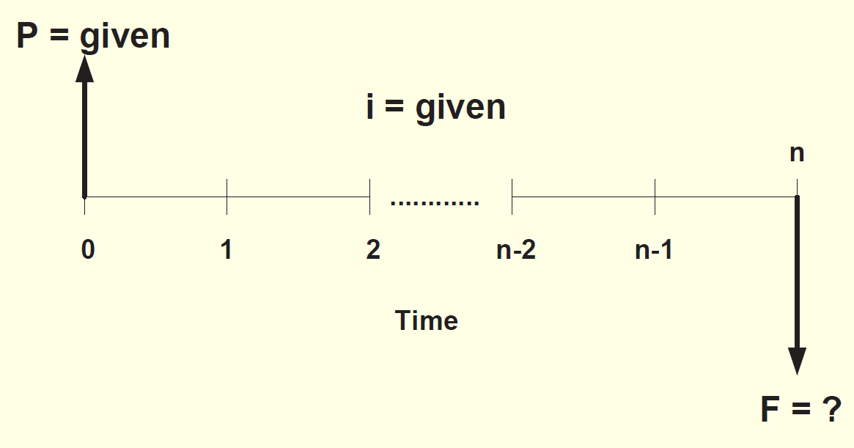
This conversion factor yields the future amount F of an initial amount P after n years at interest rate i, when it is multiplied by P.

Slide 22
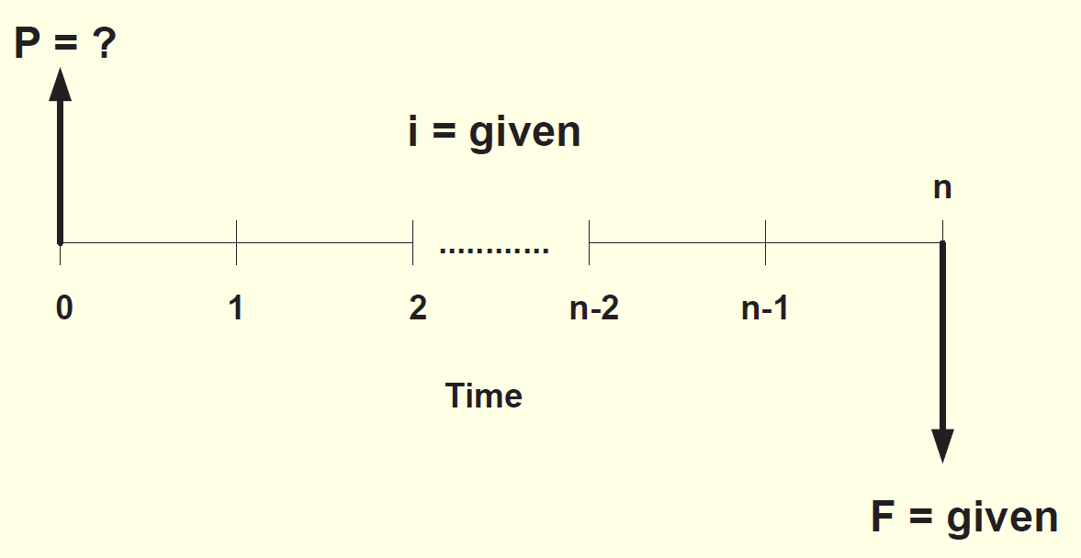
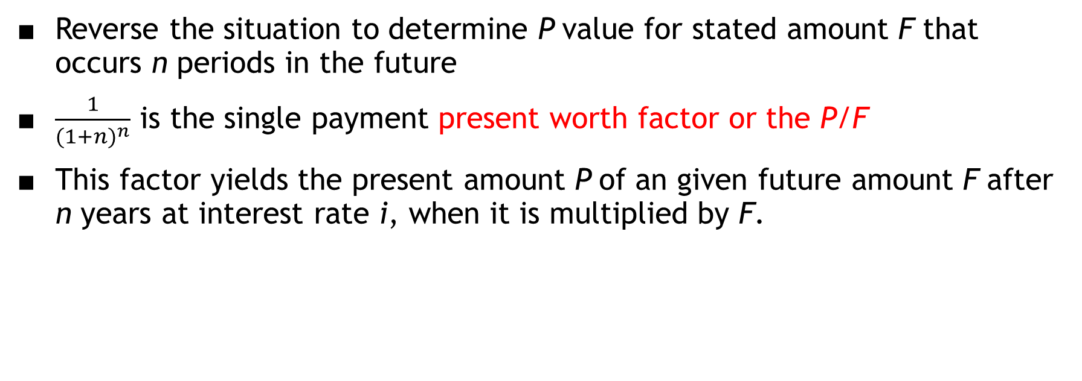
Reverse the situation to determine P value for stated amount F that occurs n periods in the future
$\frac{1}{{(1+n)}^{n}}$ is the single payment present worth factor or the P/F
This factor yields the present amount P of an given future amount F after n years at interest rate i, when it is multiplied by F.

Slide 23
The two factors derived so far are for single payments.
A standard notation is developed for all factors.
includes: two cash flow symbols, interest rate and number of periods
general form is (X/Y, i, n)
X is the cash flow that is sought
Y is the cash flow that is given
i is the interest rate in percent
n is the time periods involved
(F/P, 8%, 20) represents the factor to calculate future value F accumulated in 20 periods at 8% interest rate for an initial 1 dollar invested at time zero.
P∗(F/P, 8%, 20) gives you the future F value.

Slide 24
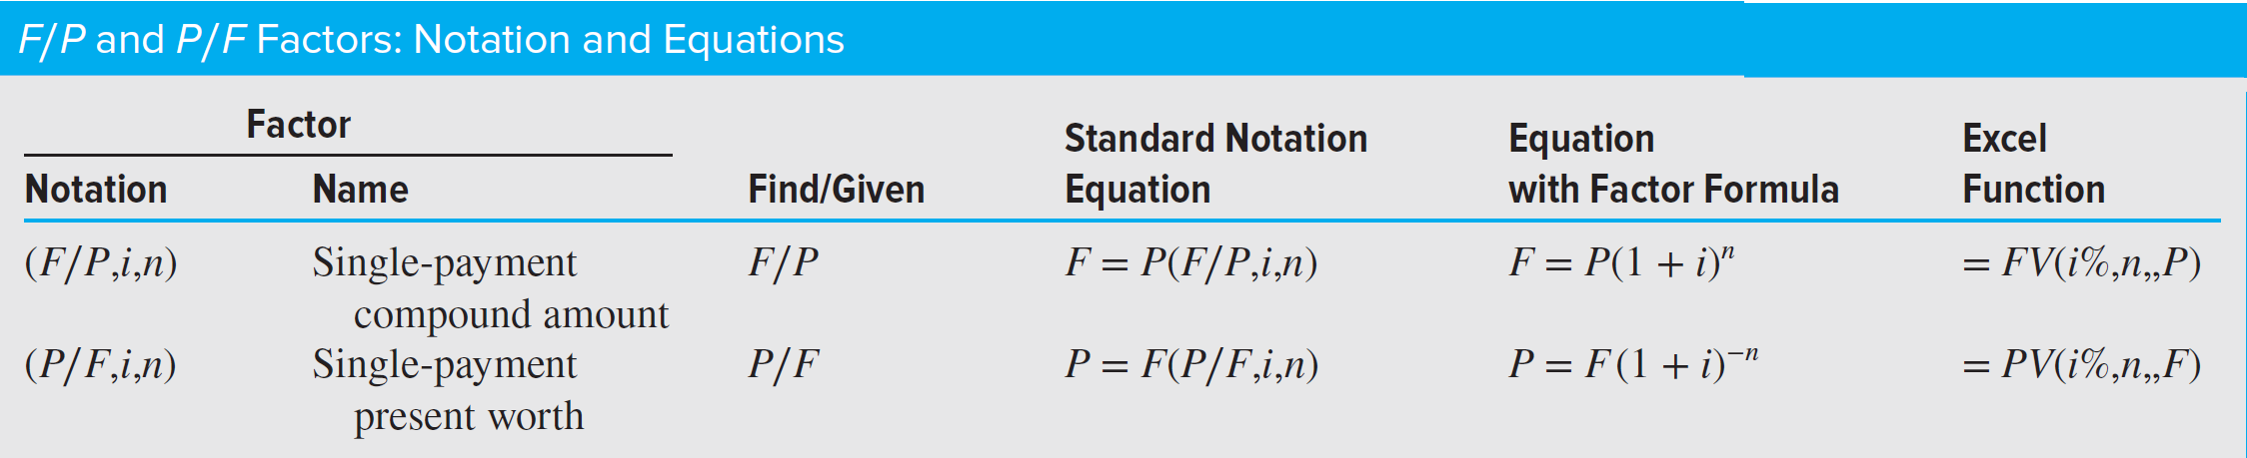
Tables of factors are available from 0.25 to 50% interest rates and time periods 1 to large n values.
For a given interest rate, the factor value is found at the intersection of the factor name and n.

Slide 25
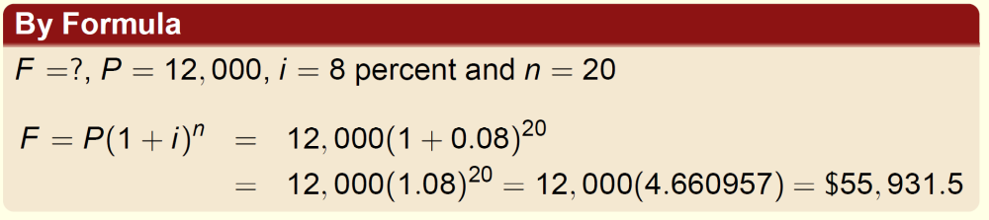
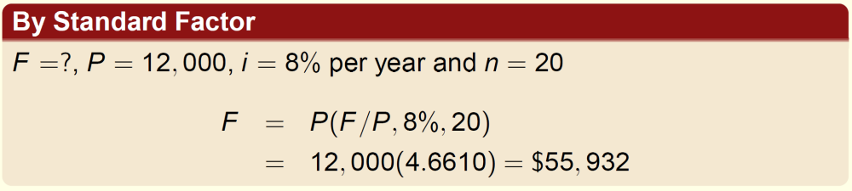
EXAMPLE
An industrial engineer receives a bonus of $12,000, and decides to invest the whole amount to the bank for 20 years at 8% per each year. Find the amount amount of money he will get 20 years later.

Slide 26
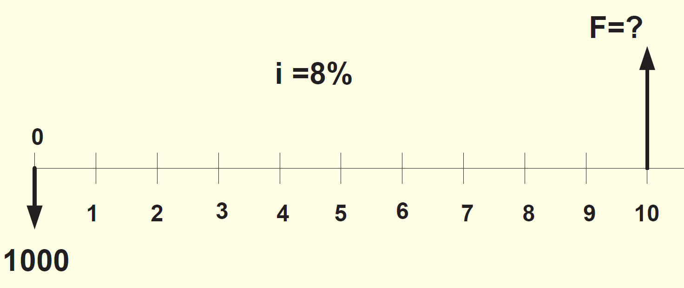
EXAMPLE
Foreman family decided to start investing to their son Eric’s college fund. They started it by depositing $1,000 on January 1, 2008 to the Washington Mutual Bank. They plan to deposit $2,000 on June 31, 2010 and $3,000 on June 31, 2013. If they manage to invest according to that plan, how much money will they have on on January 1, 2018 if the interest is taken as 8% per each year.

Slide 27
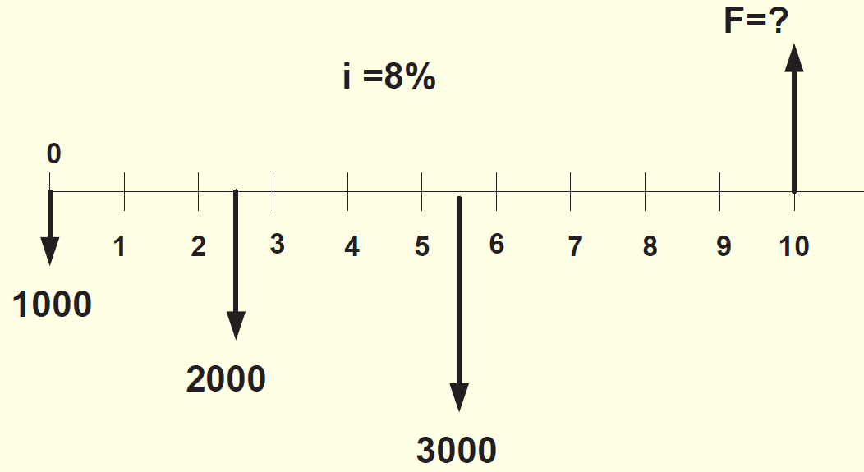
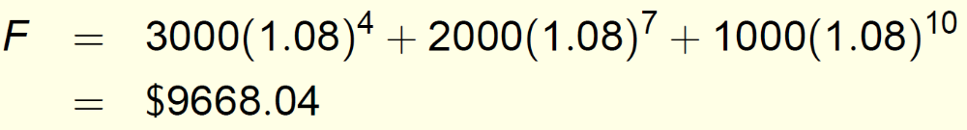

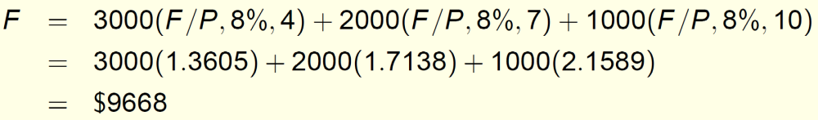

Slide 28
EXAMPLE
Howard owns a small electronics repair shop. He wants to borrow $10,000 now and repay it over the next 1 or 2 years. He believes that new diagnostic test equipment will allow him to work on a wider variety of electronic items and increase his annual revenue. Howard received 2-year repayment options from banks A and B.
Amount to Pay, $ per year
Year Bank A Bank B
1 −5,378.05 −5,000.00
2 −5,378.05 −5,775.00
Total paid −10,756.10 −10,775.00
After reviewing these plans, Howard decided that he wants to repay the $10,000 after only 1 year based on the expected increased revenue. During a family conversation, Howard’s brother-in-law offered to lend him the $10,000 now and take $10,600 after exactly 1 year. Now Howard has three options and wonders which one to take. Which one is economically the best?

Slide 29
The repayment plans for both banks are economically equivalent at the interest rate of 5% per year.
Therefore, Howard can choose either plan even though the bank B plan requires a slightly larger sum of money over the 2 years.
The brother-in-law repayment plan requires a total of $600 in interest 1 year later plus the principal of $10,000, which makes the interest rate 6% per year.
Given the two 5% per year options from the banks, this 6% plan should not be chosen as it is not economically better than the other two.
Even though the sum of money repaid is smaller, the timing of the cash flows and the interest rate make it less desirable.
The point here is that cash flows themselves, or their sums, cannot be relied upon as the primary basis for an economic decision.
The interest rate, timing, and economic equivalence must be considered.

Slide 30
Key Idea: The Time Value of Money
A dollar today is worth more than a dollar in the future. To compare loans fairly, we must consider both the timing and the interest rate of payments. This is done by converting all payments to their 'present value' (PV).
Step 1: Understanding the Bank Offers
The two bank plans are economically equivalent at a 5% interest rate. That means when we discount their payments at 5%, both have a present value of $10,000 — exactly the amount Howard is borrowing.
Step 2: The Brother-in-Law’s Offer
The brother-in-law wants $10,600 after 1 year for a $10,000 loan. This means an interest rate of:
Interest rate = (10,600 − 10,000) / 10,000 = 6% per year

Slide 31
Step 3: Comparing the Plans
At a 5% discount rate, we can compare the present values:
PV (Bank A) = 5,378.05 / 1.05 + 5,378.05 / (1.05)² = 10,000
PV (Brother-in-law) = 10,600 / 1.05 = 10,095
The brother-in-law’s offer has a higher present value, meaning it costs more economically, even though the total repayment amount looks smaller.
Conclusion
Even though the brother-in-law’s total payback ($10,600) looks smaller than the banks’ totals, the earlier repayment and higher interest rate make it more expensive in economic terms. The key lesson is: never judge a loan by the total amount repaid — always consider when the payments occur and what the interest rate is.

Slide 32
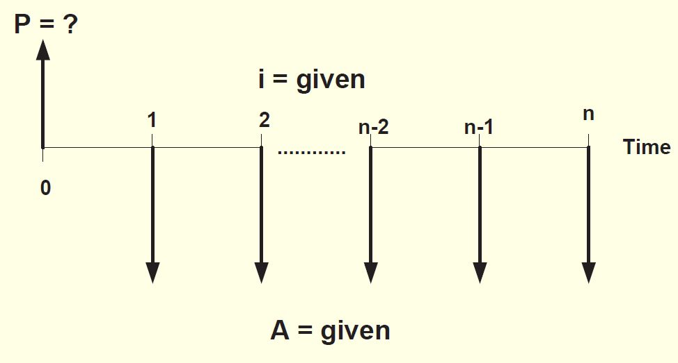
Uniform-Series Factors : (P/A and A/P)
The equivalent present worth P of a uniform series A of end-of-period cash flows can be determined by considering each A value as a future worth F and calculating its present worth with the P/F factor.

Slide 33
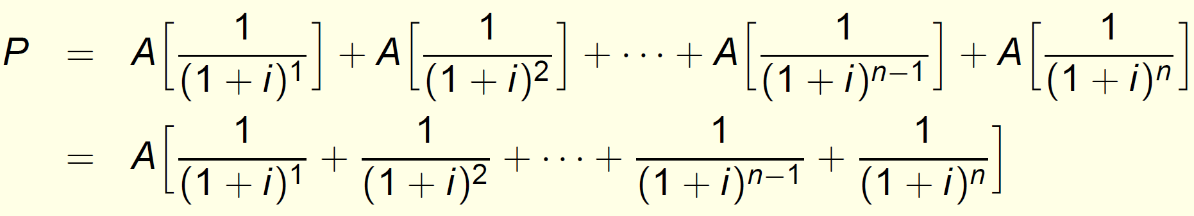

Slide 34
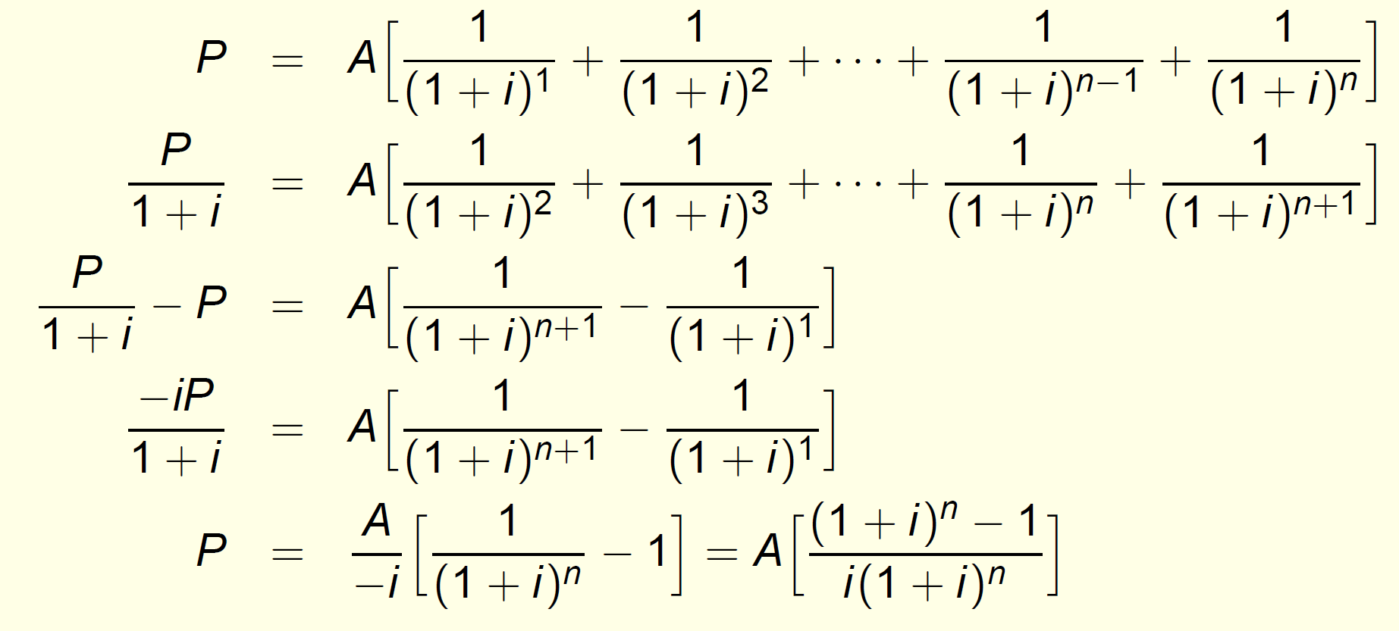

Slide 35
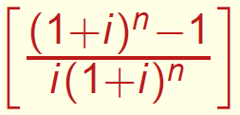
is the uniform series present worth factor, P/A factor used to calculate the equivalent present worth P in year 0 for a uniform end-of-period series of A values beginning at the end of period 1 and extending for n periods.

Slide 36
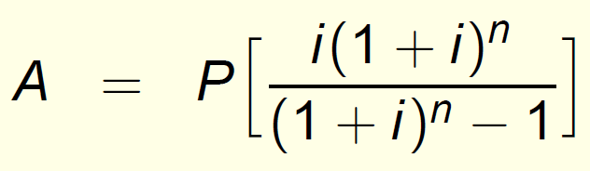
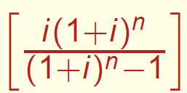
To reverse the situation, the present worth P is known and the equivalent uniform-series amount A is sought. The first A value occurs at the end of period 1. Then we have:
is the capital recovery factor or A/P factor. It calculates the equivalent uniform annual worth A over n years starting from the end of year 1 for a given P in year 0.

Slide 37
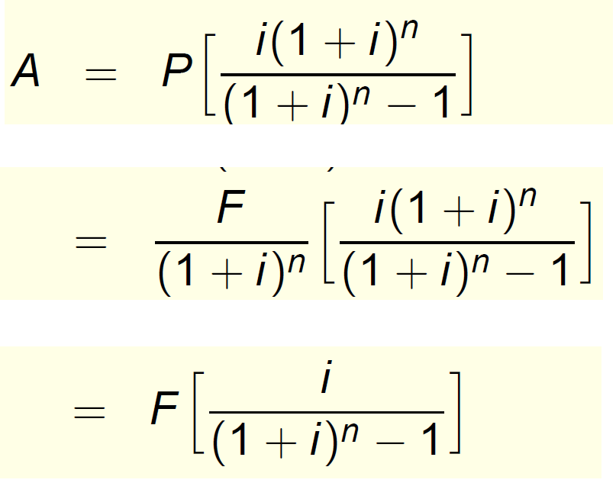
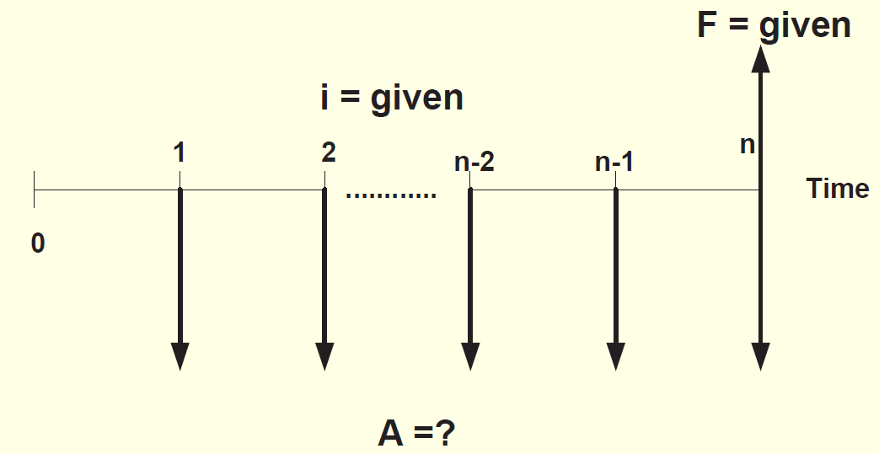
These formulas are derived with the present worth P and the first uniform annual amount A one period apart. Therefore, the present worth P must always be located one period prior to the first A.
Standard notations for these two factors are: (P/A, i%, n) and (A/P, i%, n).
This time, the cash flow diagram we are dealing with is:

Slide 38
